Slide 1
Module - 4
Media Access Control

Slide 2
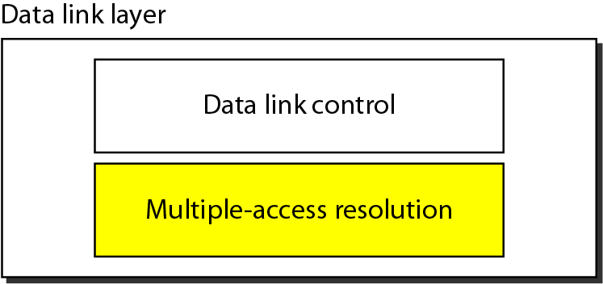
Media Access Control
The stations are connected and use a common link called a multipoint .
It needs a multiple-access protocol to coordinate access to the link.
The protocols belong to a sub layer in the data-link layer called Media Access Control (MAC).

Slide 3
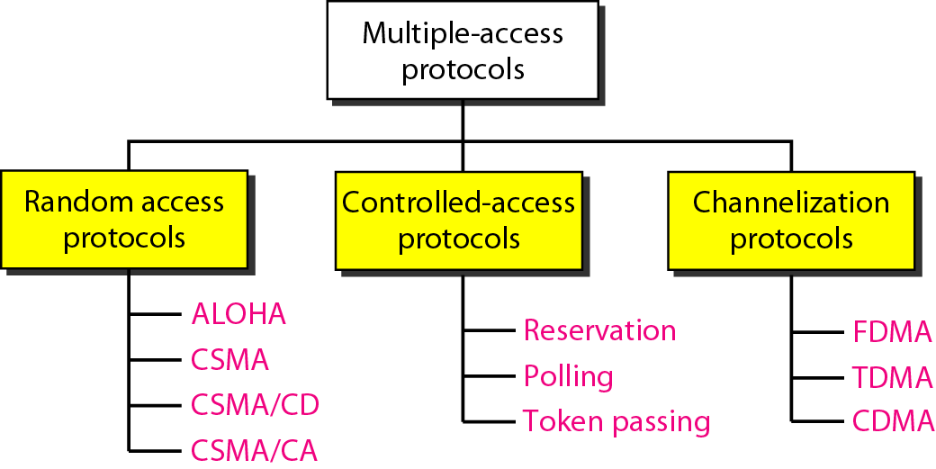
Multiple-Access Protocols

Slide 4
Random Access
In random access methods, no station is superior to another station and none is assigned the control over another.
No station permits, or does not permit, another station to send.
A station that has data to send uses a procedure defined by the protocol to make a decision on whether or not to send.
Two features make a random access name:
Transmission is random among the stations.
Stations compete with one another to access
the medium.

Slide 5
In a random-access method, if more than one station tries to send, there is an access conflict or collision and the frames will be either destroyed or modified.
To avoid access conflict, each station follows a procedure.
ALOHA is used a very simple procedure called Multiple Access (MA).

Slide 6
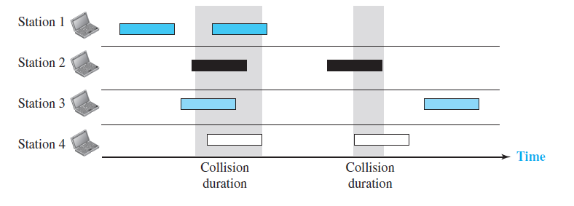
Pure ALOHA
The original ALOHA protocol is called pure ALOHA.
Each station sends a frame.
There is only one channel to share, possibility of collision between frames from different stations.

Slide 7
The frames collide as multiple frames are in contention for the shared channel.
When a station sends a frame, it expects the receiver to send an acknowledgment.
After a time-out period, the station assumes that the frame is lost and resends the frame.
In Pure ALOHA, each station waits a random amount of time before resending its frame this time is called the backoff time TB.
The time-out period is equal to the maximum possible round-trip propagation delay, which is twice the amount of time required to send a frame between the two most widely separated stations (2 × Tp).

Slide 8
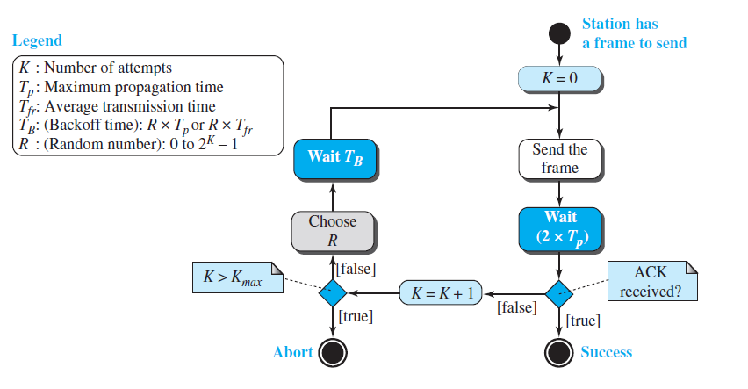
Procedure for Pure ALOHA protocol
Pure ALOHA prevents congesting the channel with retransmitted frames.
After a max number of retransmission, Kmax(15)

Slide 9
Example 12.1

Slide 10
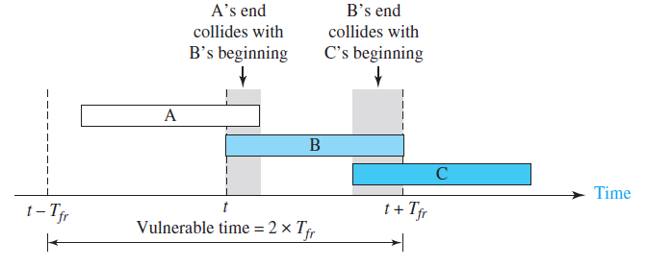
Vulnerable time
The length of time in which there is a possibility of collision.
The vulnerable time during which a collision is 2 times the frame transmission time.
Pure ALOHA vulnerable time =2 x Tfr

Slide 12
Throughput
The average number of successfully transmitted
frames for pure ALOHA is S = G × e^{−2G.}
G - average number of frames generated by the system during one frame transmission time.
The max throughput Smax =0.184,for G =1/2.
If one-half a frame is generated during one frame transmission time, then 18.4 % frames reach their destination successfully.
Therefore ,if a station generates only one frame in this vulnerable time then it reaches the destination successfully.

Slide 14
Problem
A pure ALOHA network transmits 200-bit frames on a shared channel of 200 kbps. What is the
throughput if the system (all stations together) produces
a. 1000 frames per second?
b. 500 frames per second?
c. 250 frames per second?.

Slide 15
Solution
The frame transmission time is 200/200 kbps or 1 ms.
If the system creates 1000 frames per second, or 1 frame per millisecond, then G = 1.
In this case S = G × e^{−2G} = 0.135 (13.5 percent). This means that the throughput is 1000 ×0.135 = 135 frames. Only 135 frames out of 1000 will probably survive.
b. If the system creates 500 frames per second, or 1/2 frames per millisecond, then G = 1/2.
In this case S = G × e ^{−2G} = 0.184 (18.4 percent). This means that the throughput is 500 ×0.184 = 92 and that only 92 frames out of 500 will probably survive.
c. If the system creates 250 frames per second, or 1/4 frames per millisecond, then G = 1/4.
In this case S = G × e ^{−2G} = 0.152 (15.2 percent). This means that the throughput is 250 × 0.152 = 38. Only 38 frames out of 250 will probably survive.

Slide 16
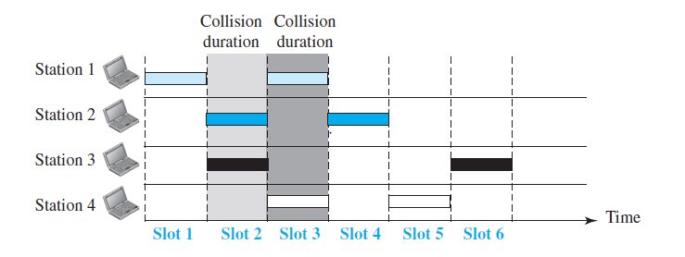
Slotted ALOHA
In slotted ALOHA, divide the time into slots of Tfr seconds and force the station to send only at the beginning of the time slot.
The possibility of collision, if two stations try to send at the beginning of the same time slot.

Slide 17
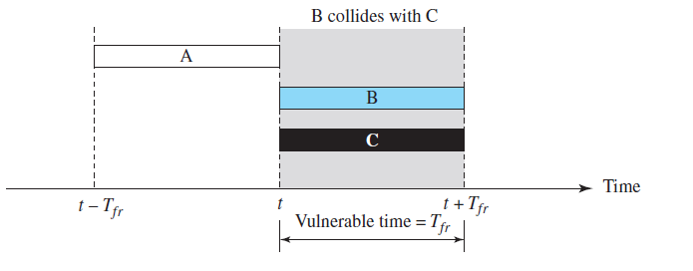
Vulnerable time
Slotted ALOHA vulnerable time = Tfr

Slide 18
Throughput
The average number of successful transmissions for slotted ALOHA is S = G × e^{−G.} The maximum throughput Smax is 0.368, when G = 1.
If one frame is generated during one frame transmission time, then 36.8 percent of these frames reach their destination successfully.

Slide 19
Problem
A slotted ALOHA network transmits 200-bit frames using a shared channel with a 200-kbps bandwidth. Find the throughput if the system (all stations together) produces
a. 1000 frames per second.
b. 500 frames per second.
c. 250 frames per second.

Slide 20
Solution
This situation is similar to the previous exercise except that the network is using slotted ALOHA instead of pure ALOHA. The frame transmission time is 200/200 kbps or 1 ms.
a. In this case G is 1. So S = G × e−G = 0.368 (36.8 percent). This means that the throughput is 1000 × 0.0368 = 368 frames. Only 368 out of 1000 frames will probably survive. Note that this is the maximum throughput case, percentagewise.
b. Here G is 1/2. In this case S = G × e−G = 0.303 (30.3 percent). This means that the throughput is 500 × 0.0303 = 151. Only 151 frames out of 500 will probably survive.
c. Now G is 1/4. In this case S = G × e−G = 0.195 (19.5 percent). This means that the throughput is 250 × 0.195 = 49. Only 49 frames out of 250 will probably survive.

Slide 21
Carrier Sense Multiple Access(CSMA)
Each station first listen to the medium before sending.
Minimize the chance of collision, increase the performance.
The principle is “sense before transmit”.
It reduces the possibility of collision, cannot eliminate it.
A space and time model of a CSMA network.

Slide 22
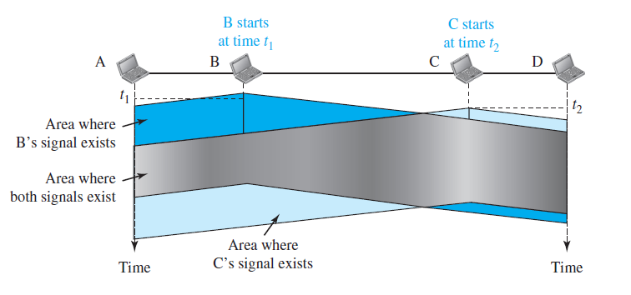
Space/time model of a collision in CSMA

Slide 23
A station sends a frame, it takes time for the first bit to reach every station and to sense.
At time t1, station B senses the medium and finds it idle, so it sends a frame.
At time t2 (t2 > t1), station C senses the medium and finds it idle.
At this time, the first bits from station B have not reached station C.
Station C also sends a frame.
The two signals collide and both frames are destroyed.
The possibility of collision still there because of propagation delay.

Slide 24
Vulnerable Time
The vulnerable time for CSMA is the propagation time Tp.
The time needed for a signal to propagate from one end of the medium to the other.
A station sends a frame and any other station tries to send a frame during this time, a collision will result.
If the first bit of the frame reaches the end of the medium.
Every station have heard the bit and will refrain from sending.

Slide 25
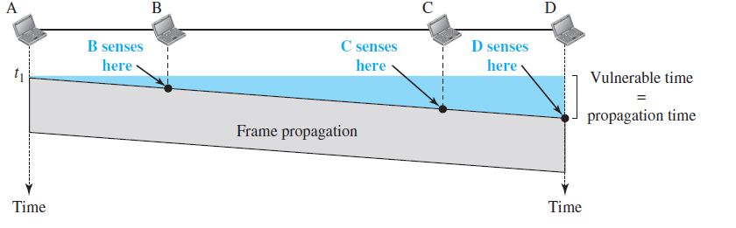
Station A, sends a frame at time t1, which reaches the rightmost station, D at time t1 + Tp.

Slide 26
Persistence Methods
A station needs to find if the channel is busy or idle?
To do this, there are three persistence methods
1-persistent
Nonpersistent
p-persistent.

Slide 27
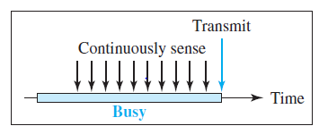
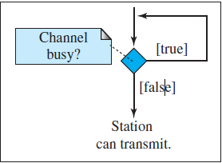
1-Persistent
The station finds the line idle, it sends its frame immediately (with probability 1).
This method has more of collision because two or more stations may find the line idle.
It sends their frames immediately.

Slide 28
Nonpersistent
A station has a frame to send senses the line.
If the line is idle, it sends immediately.
If not idle, waits a random amount of time and then senses again.
It reduces the chance of collision but if two or more stations will wait the same amount of time and retry to send simultaneously, it reduces the efficiency of the network as the medium remains idle when there are frames to send.

Slide 29
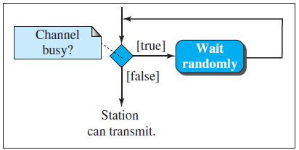
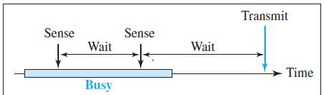

Slide 30
p-Persistent
It is used if the channel has time slots with , slot duration >=maximum propagation time.
It reduces the chance of collision and improves efficiency.
The station finds the line idle it follows these steps:
Probability p, the station sends its frame.
Probability q = 1 − p, the station waits for the beginning of the next time slot and checks the line again.
a. If the line is idle, it goes to step 1.
b. If the line is busy, a collision occurred and uses the backoff procedure.

Slide 31
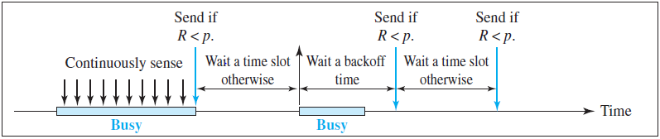

Slide 32
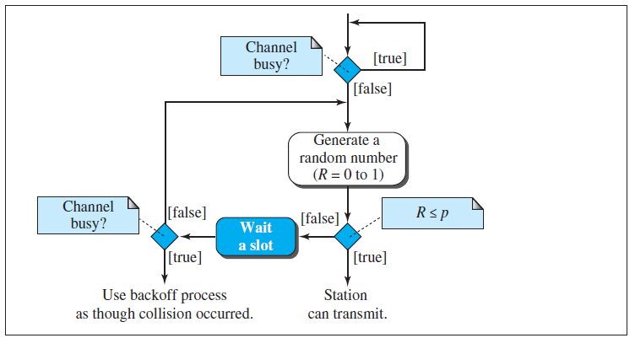
Flow diagram

Slide 33
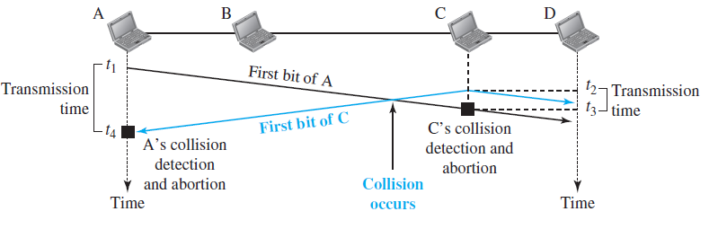
Carrier Sense Multiple Access with Collision Detection
A station monitors the medium after it sends a frame.
If the transmission was successful or not
If there is a collision, the frame is sent again.

Slide 34
At time t1, station A has executed its persistence procedure and starts sending the bits of its frame.
At time t2, station C has not yet sensed the first bit . Station C executes its persistence procedure and starts sending the bits in its frame.
The collision occurs sometime after time t2.
Station C detects a collision at time t3 when it receives the first bit of A’s frame.
Station C aborts transmission.
Station A detects collision at time t4 when it receives the first bit of C’s frame it also immediately aborts transmission.
A transmits for the duration t4 − t1
C transmits for the duration t3 − t2.

Slide 35
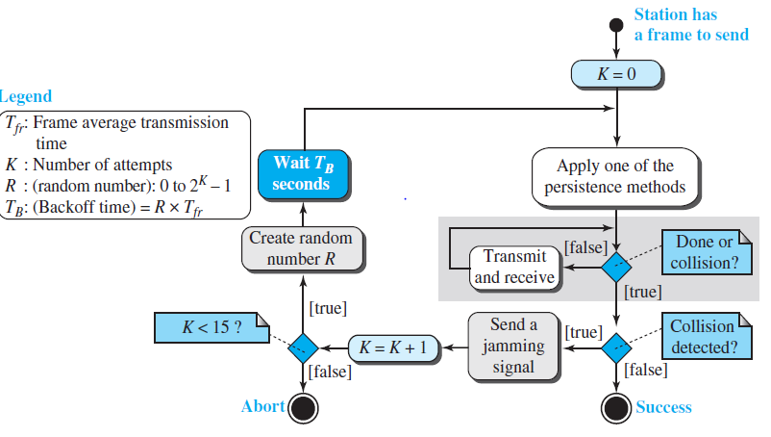
Flow diagram for the CSMA/CD

Slide 36
It is similar to the one for the ALOHA protocol, but there are differences.
Sense the channel before start sending the frame by using one of the persistence processes
In CSMA/CD, transmission and collision detection are continuous processes. It constantly monitors to detect either transmission is finished or a collision is detected.
Sending a jamming signal to make sure that all other stations become aware of the collision.

Slide 37
Minimum Frame Size
In CSMA/CD, before sending the last bit of the frame, the sending station must detect a collision, if any, abort the transmission.
The frame transmission time Tfr is at least two times the maximum propagation time Tp.
Eg: Network using CSMA/CD has a bandwidth of 10 Mbps. If the maximum propagation time is 25.6 μs, what is the minimum size of the frame?
The minimum frame transmission time
Tfr = 2 × Tp = 51.2 μs.
The minimum size of the frame
10 Mbps × 51.2 μs = 512 bits or 64 bytes(Ethernet).

Slide 38
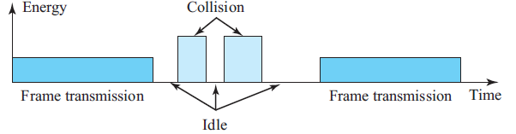
Energy Level
The level of energy in a channel can have three values: zero, normal, abnormal.
At the Zero level, the channel is idle.
At the Normal level, a station has successfully sending its frame.
At the Abnormal level, there is a collision and the level of the energy is twice the normal level.
A station that has a frame to send needs to monitor the energy level if the channel is idle, busy, or in collision mode.

Slide 39
Throughput
The throughput of CSMA/CD is greater than that of pure or slotted ALOHA.
The maximum throughput occurs at a different value of G ,based on the persistence method
For 1-persistent method, the maximum throughput is around 50 percent when G = 1.
For Nonpersistent method, the maximum throughput can go up to 90 percent when G is between 3 and 8.
For p-persistent method, depends on the value of p

Slide 40
Carrier sense multiple access with collision avoidance (CSMA/CA)
CSMA/CA is used for wireless networks.
CSMA/CA avoids collisions by using the three strategies:
InterFrame Space
Contention window
Acknowledgment

Slide 42
Interframe Space (IFS)
The station does not send immediately, even if an idle channel is found.
It waits for a period of time called the InterFrame space(IFS).
After waiting an IFS time, if the channel is still idle, the station can send, but it still needs to wait a time equal to the contention window (time divided into slots).
The IFS variable can also be used to prioritize stations or frame types.

Slide 43
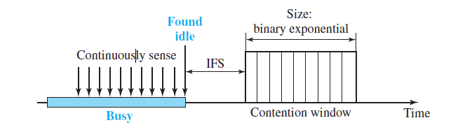
Contention Window
It is an amount of time divided into slots.
A station that is ready to send chooses a random number of slots as its wait time.
The number of slots in the window changes according to the binary exponential backoff strategy{0,1}.
The station needs to sense the channel after each time slot.
If it finds the channel busy, it does not restart the process, it stops the timer and restarts it when the channel is sensed as idle.
Priority is given to the station with the longest waiting time.

Slide 44
Acknowledgment
With all these precautions, there still may be a collision resulting in destroyed data. The data may be corrupted during the transmission.
The positive acknowledgment and the time-out timer can help guarantee that the receiver has received the frame.

Slide 45
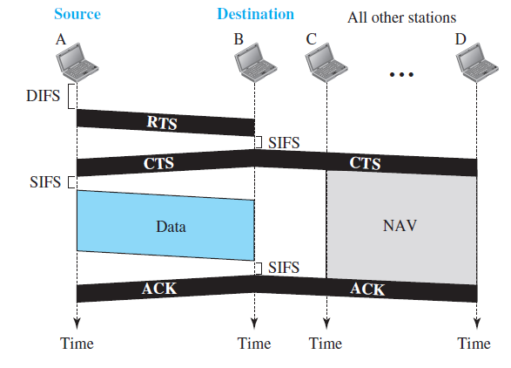
Frame Exchange Time Line
The exchange of data and control frames in time is as follows.

Slide 46
Before sending a frame, the source station senses the medium by checking the energy level at the carrier frequency.
a. The channel uses a persistence strategy with backoff until the channel is idle.
b. After the station is found to be idle, the station waits for a period of time called the DCF InterFrame Space (DIFS) then the station sends a control frame called the Request To Send (RTS).
After receiving the RTS and waiting a period of time called the Short InterFrame Space (SIFS), the destination station sends a control frame, called the Clear To Send (CTS) to the source station. This indicates that the destination station is ready to receive data.

Slide 47
The source station sends data after waiting an amount of time equal to SIFS.
The destination station after waiting an amount of time equal to SIFS, sends an acknowledgment to show that the frame has been received.
Acknowledgment is needed in this protocol because the station does not have any means to check for the successful arrival of its data at the destination.

Slide 48
Network AllocationVector
When a station sends an RTS frame, it includes the duration of time that it needs to occupy the channel. The stations that are affected by this transmission create a timer called a Network Allocation Vector (NAV)
It is how much time must pass before these stations are allowed to check the channel for idleness. Each time a station accesses the system and sends an RTS frame, other stations start their NAV.

Slide 49
CONTROLLED ACCESS
The stations consult one another to find which station has the right to send.
A station cannot send until it is authorized by the other stations.
The three controlled-access methods are:
Reservation
Polling
Token Passing

Slide 50
Reservation
A station needs to make a reservation before sending data.
Here time is divided into intervals.
In each interval, a reservation frame precedes the data frames sent in that interval.
If there are N stations in the system, there are N reservation mini slots in the reservation frame.
When a station needs to send a data frame, it makes a reservation in its own mini slot.
It sends their data frames after the reservation frame.

Slide 51
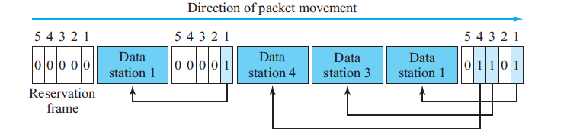
Example
There are five stations and a five-mini slot reservation frame.
In the first interval, only stations 1, 3, and 4 have made reservations.
In the second interval, only station 1 has made a reservation.

Slide 52
Polling
Polling works with topologies in which one device is a primary station and other devices as secondary stations.
The primary device controls the link and the secondary devices follow its instructions.
Therefore, the primary device is always the initiator of a session.
This method uses poll and select functions to prevent collisions.
The drawback is if the primary station fails, the system goes down.

Slide 53
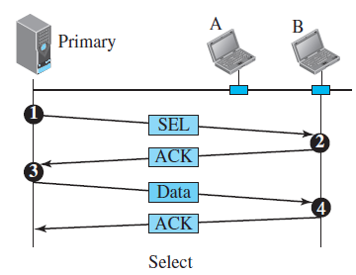
Select
The primary device has something to send then select is used.
If the primary is neither sending nor receiving data, it knows the link is available.
Before sending data, the primary creates and transmits a select(SEL) frame.
It includes the address of that secondary and wait
for an acknowledgment.

Slide 54
Poll
It is used by the primary device to request transmissions from the secondary devices.
When the primary is ready to receive data, it must poll each device if it wants to send or receive.
The first secondary is nearer, it responds either with a NAK frame if it has nothing to send or with data.
If the response is a NAK frame, then the primary
polls the next secondary until it finds one with data to send.
When the response is positive the primary reads the frame and returns an acknowledgment (ACK frame)

Slide 55
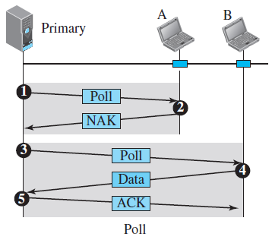

Slide 56
Token Passing
The stations in a network are organized in a logical ring.
For each station, there is a predecessor and a successor.
A special packet called a token circulates through the ring.
The token gives the station the right to access the channel and send its data.
When a station has data to send, it waits until it receives the token from its predecessor.

Slide 57
It then holds the token and sends its data. When the station has no more data to send, it releases the token, passing it to the next logical station in the ring.
The station cannot send data until it receives the token again in the next round.
Token management is needed for this access method.
It can assign priorities to the stations and to the types of data being transmitted.
The token must be monitored to see if it has
not been lost or destroyed.

Slide 58
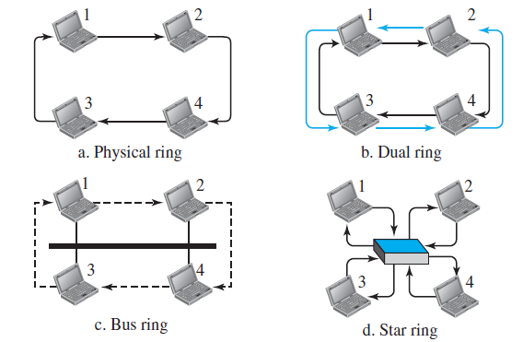
Logical Ring
In a token-passing network, stations do not have to be physically connected in a ring it’s logical one.

Slide 59
The high-speed Token Ring networks called FDDI (Fiber Distributed Data Interface) and CDDI (Copper Distributed Data Interface).
The Token Bus LAN, standardized by IEEE.
The Token Ring LAN designed by IBM.

Slide 60
CHANNELIZATION
Channelization is a multiple-access method in which the bandwidth of a link is shared in time, frequency, or through code, among different stations.
The three channelization protocols are: FDMA
TDMA
CDMA.

Slide 61
FDMA
FDMA, is an access method in the data-link layer.
The available bandwidth is divided into frequency bands.
Each station is allocated a band to send its data.
The allocated bands are separated from one another by small guard bands to prevent interferences.
The channels that are combined is low-pass. The multiplexer modulates the signals, combines them, and creates a bandpass signal.
This signal must be created in the allocated band.

Slide 62
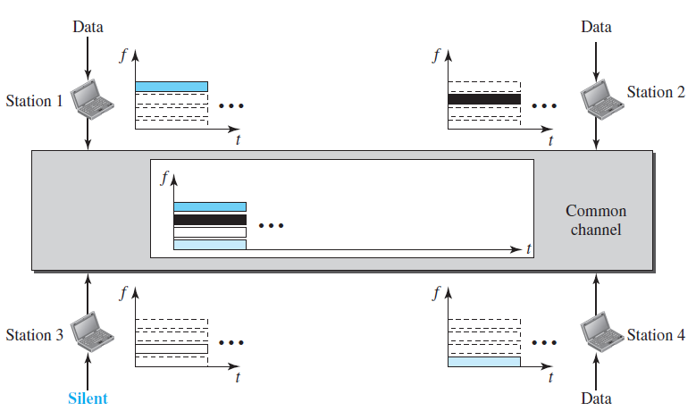

Slide 63
TDMA
TDMA, is an access method in the data-link layer
The stations share the bandwidth of the channel in time.
Each station is allocated a time slot during which it can send data.
It has to achieving synchronization between the different stations.
Synchronization is done by having synchronization bits at the beginning of each slot.

Slide 64
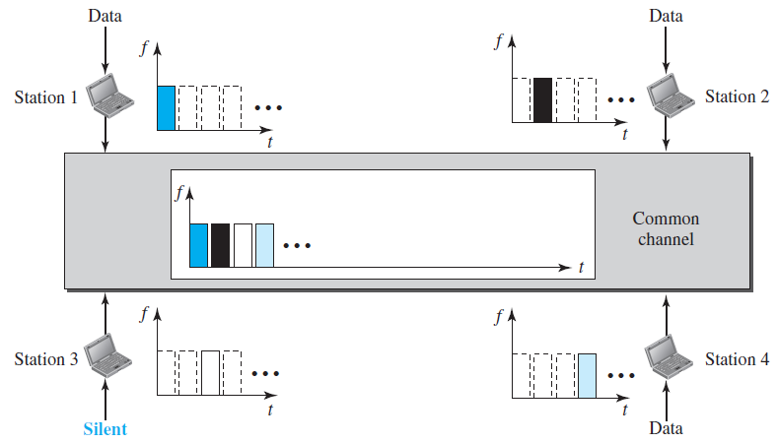

Slide 65
CDMA
In CDMA, one channel carries all transmissions simultaneously.
It differs from FDMA, only one channel occupies the entire bandwidth of the link.
It differs from TDMA, all stations can send data simultaneously, no timesharing.

Slide 66

Idea
The four stations 1, 2, 3, 4 are connected to the same channel.
The data from station 1 is d1, station 2 is d2, …..
The code to first station is c1, second is c2,……
The assigned codes have two properties.
1. Multiply each code by another, get 0.
2. Multiply each code by itself, get 4 (the number of stations).

Slide 67
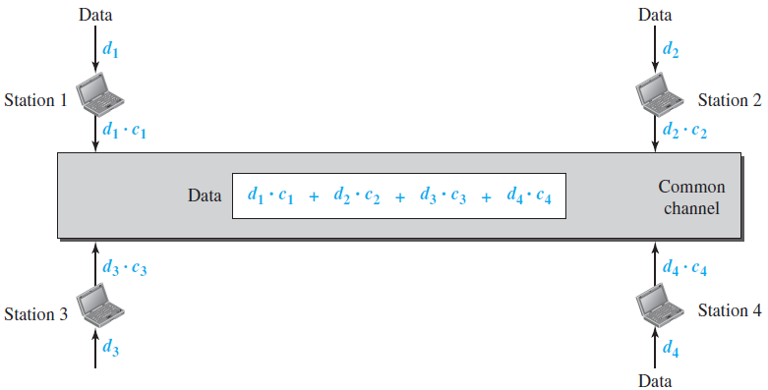

Slide 68

Chips
CDMA is based on coding theory.
Each station is assigned a code, which is a sequence of numbers called chips.
Below is the chip sequence numbers for the code.

Slide 69
The orthogonal sequences has the following properties:
Each sequence is made of N elements, where N is the number of stations.
If we multiply a sequence by a number, every element in the sequence is multiplied by that element(scalar).
If we multiply two equal sequences, element by element, get N, where N is the number of elements in each sequence. This is called the inner product of two equal sequences.

Slide 70
If we multiply two different sequences, element by element, get 0. This is called the inner product of two different sequences.
5. Adding two sequences means adding the corresponding elements. The result is
another sequence.

Slide 71

Data Representation
The rules for encoding:
If a station needs to send a 0 bit, it encodes it as −1.
If it needs to send a 1 bit, it encodes it as +1.
When a station is idle, it sends no signal, which is interpreted as a 0.

Slide 72
Encoding and Decoding
The stations 1 and 2 are sending a 0 bit and channel 4 is sending a 1 bit. Station 3 is silent.
The data at the sender site are translated to −1, −1, 0, and +1.
Each station multiplies with the corresponding number by its chip(unique).
The result is a new sequence which is sent to the channel.
The sequence on the channel is the sum of all four sequences.

Slide 73
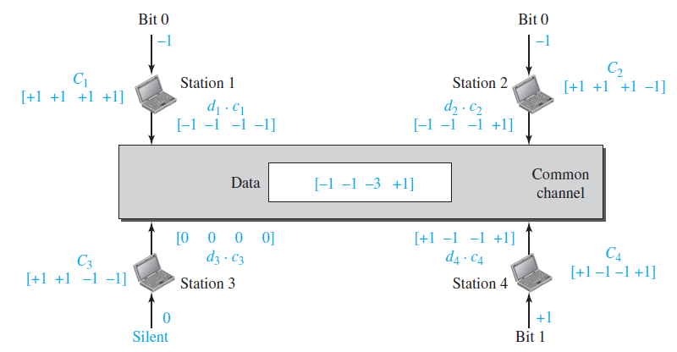

Slide 74
Signal Level
Signals for each station using NRZ-L and the signal that is on the common channel.
How the station 3 can detect the data sent by station 2 by using the code for station 2.
The total data on the channel are multiplied by the signal representing station 2 chip code to get a new signal.
The station then integrates and adds to get the value −4, which is divided by 4 and interpreted as bit 0.

